Slide 1
The US Presidential Election and its Impact on India-US Trade
Notes:
Entered text
Introduction
The U. S. presidential election is important for the US-India trade relation but it is believed that no matter the outcome, the bilateral relationship between them will remain healthy and warm The Indian External Affairs Minister, S Jaishankar, also stated that they regard whoever will assume the presidency of the United States shortly, will continue a healthy and strategic economic cooperation with India. Bilateral trade is another factor that defines the relations between the two countries. U. S. remains one of the leading trading partners of India with its striking technology, defense, and energy industries throughout the years. However, election results might affect a particular sphere, including tariffs, supply chain relationships, and technological and defense cooperation (CSIS). Furthermore, both countries are experiencing issues similar to protectionism and competition over vital industries ranging from semiconductors to farming.
External Affairs minister of India , Dr. S .Jaishankar affirmed that regardless of election outcome, a consistent well built trade relationship has been maintained between India and US since a few decades.
He emphasized India's policy of not commenting on other countries' elections, hoping for reciprocal respect and said "The American system will throw up its verdict, and I am not saying just as a formality, but if you look at the last 20 odd years, maybe a little bit more, for us, we have every confidence that we will be able to work with the President of the United States, whoever he or she will be,"

Slide 2
Introduction
The U. S. presidential election is important for the US-India trade relation but it is believed that no matter the outcome, the bilateral relationship between them will remain healthy and warm. Election results might affect a particular sphere, including tariffs, supply chain relationships, and technological and defense cooperation (CSIS).

Slide 3
The US India Bilateral Partnership
The U.S.-India bilateral partnership has run on two parallel tracks of engagement for several decades–the strategic and defense partnership on one side, and the economic and trade relationship on the other.
In the past two years, India has been designated as a "Major Defense Partner" by the U.S. and granted "Strategic Trade Authorization-1" (STA-1) status, joining an elite group of NATO allies. This recognition, along with foundational military agreements like LEMOA and COMCASA, enables closer military cooperation, data sharing, and the export of sensitive U.S. technologies to India.

Slide 4
India US Trade and Investment

Slide 5
 | 2013 | 2014 | 2015 | 2016 | 2017 | 2018
India's exports to US | 41.8 | 45.4 | 44.8 | 46.0 | 48.6 | 54.4
% change | 3.2 | 8.5 | -1.2 | 2.8 | 5.7 | 11.9
India’s imports from US | 21.8 | 21.5 | 21.5 | 21.7 | 25.7 | 33.1
% change | -1.3 | -1.4 | -0.2 | 0.9 | 18.7 | 28.9
India US Trade in Goods | 63.6 | 66.9 | 66.3 | 67.7 | 74.3 | 87.5
% change | 1.6 | 5.2 | -0.9 | 2.1 | 9.8 | 17.8

Slide 6
 | 2013 | 2014 | 2015 | 2016 | 2017 | 2018
India's exports to US | 20.4 | 22.4 | 24.6 | 25.8 | 28.1 | 28.8
% change | 8.5 | 9.8 | 9.8 | 4.9 | 8.9 | 2.2
India’s imports from US | 13.3 | 15.2 | 18.4 | 20.6 | 23.7 | 25.8
% change | 8.1 | 14.3 | 21.0 | 12.0 | 15 | 8.6
India - US Trade in Services | 33.7 | 37.6 | 43.0 | 46.4 | 51.9 | 54.6
% change | 8.4 | 11.6 | 14.4 | 8.0 | 11.6 | 5.2

Slide 7
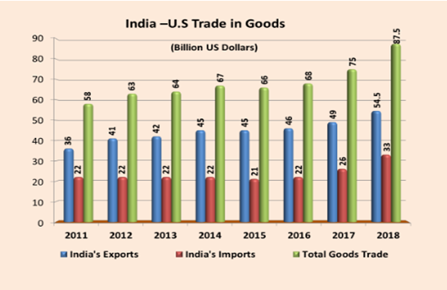

Slide 8
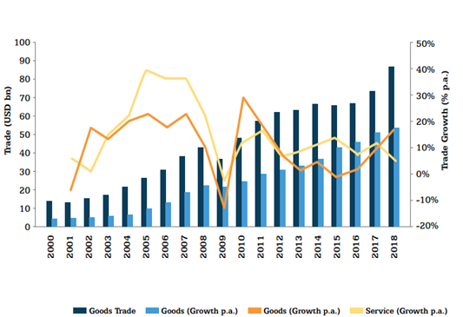

Slide 9
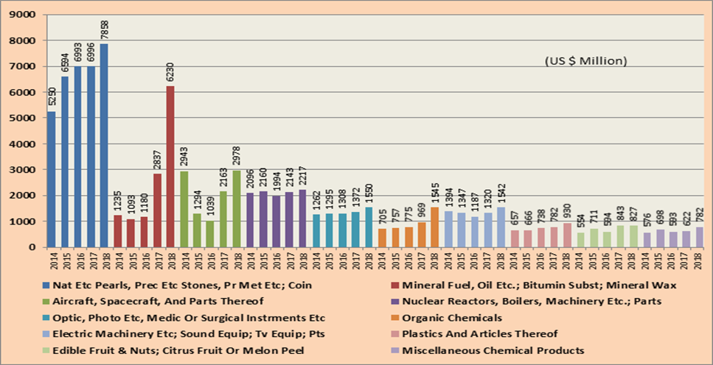

Slide 10
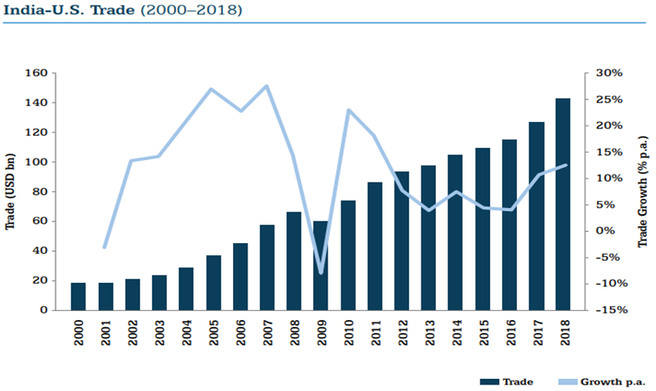

Slide 11
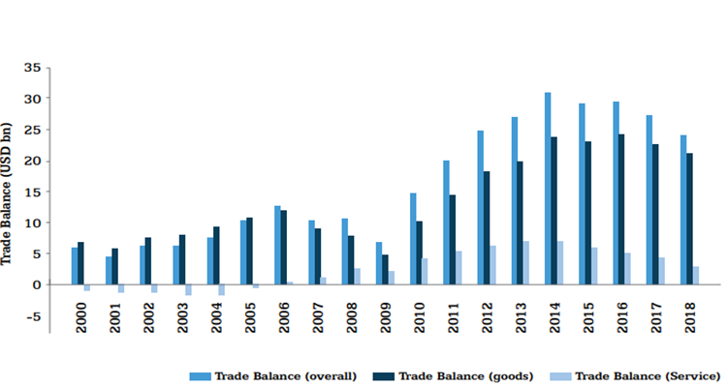

Slide 12
Gravity Model of Trade Analysis of Bilateral Trade Between India and USA

Slide 13
Model Structure
The gravity model of international trade is a model that, in its traditional form, predicts bilateral trade flows based on the economic sizes (GDP) and distance between two units. Research shows that there is overwhelming evidence that trade tends to fall with distance.
ln TRADEij,t =0+ 1 ln GDPi + 2 ln GDPj + 3 ln Dij + 4 t+ ij,t
Data Description
The data used in this analysis has been collected from various data sources such as World Bank, IMF and contains information on the following variables:
TRADE: The trade volume between India and the USA (Imports + Exports).
GDPi: GDP of USA.
GDPj: GDP of the India.
Dij: Distance between India and the USA.
t: Time variable from 2000 to 2019.

Slide 14
Interpretation of Results
Economic Size (GDP)
ln GDPi : The coefficient of 2.1496 is positive and statistically significant (p-value = 0.002). This implies that a 1% increase in USA's GDP is associated with approximately a 2.15% increase in trade volume with India, ceteris paribus.
ln GDPj : The coefficient of 0.9753 is also positive and statistically significant (p-value = 0.000). A 1% increase in the India's GDP is associated with approximately a 0.98% increase in trade volume with USA. The coefficient of 2.1496 is positive and statistically significant (p-value = 0.002). This implies that a 1% increase in USA's GDP is associated with approximately a 2.15% increase in trade volume with India, ceteris paribus.
Distance
ln Dij : The coefficient of ln Dij is -7.8081, which is negative and statistically significant (p-value = 0.000). This indicates that distance plays a crucial role in reducing trade volume. Specifically, a 1% increase in distance is associated with approximately a 7.81% decrease in trade volume.
This result, once again aligns, with the Gravity Model's prediction that greater distances increase trade costs, thereby reducing trade flows.
Time (t)
t : The coefficient of time (t) is -0.0334, with a p-value of 0.002. This suggests a small but statistically significant decline in trade over the observed period, which could be attributed to factors such as shifts in trade policies, global economic conditions, or structural changes in either economy
Model Fit
R-squared: The high R-squared value of 0.992 indicates that the model explains 99.2% of the variation in the log of trade volume.
Durbin-Watson: The Durbin-Watson statistic of 1.821 suggests no serious autocorrelation in the residuals, indicating that the model's assumptions are likely met.

Slide 15
Conclusion
The pooled OLS analysis of the Gravity Model of Trade between India and the USA from 2000 to 2019 reveals several key insights:
Economic size significantly drives trade flows, with both countries' GDPs positively influencing the trade volume.
Distance has a substantial negative effect on trade, thereby implying that the increased costs associated with geographical separation reduces trade.
Time shows a small decline in trade over the period, suggesting the influence of dynamic factors not captured by the model.

Slide 16
Withdrawal of Generalized System of Preferences from India

Slide 17
The European Union's (EU) decision to withdraw the Generalized System of Preferences (GSP) for India marks a significant shift in trade relations between the two economies. The GSP, introduced to support developing countries by providing preferential access to markets through reduced or zero tariffs, has played a crucial role in enhancing exports from beneficiary countries like India. However, India's steady economic growth and increasing competitiveness have led to its graduation from several sectors under the GSP, raising concerns about the potential impact on its economy, particularly in labor-intensive sectors.

Slide 18
Methodologies Employed
Trade Data: Data was collected from ITC's Trade Map, providing export performance indicators at the HS 6 level, allowing for a detailed analysis of tariff lines affected by the GSP withdrawal.
Tariff Data: The report utilized MFN tariff data from UN Comtrade, applying these uniformly to Indian exports, except where GSP preferences previously applied.
Weighted Shock Calculation: Tariff differentials were calculated at the GTAP sector level, introducing a trade shock that reflects the impact of the GSP withdrawal.
Dynamic GTAP Model: The GTAP model was extended to 2042, incorporating macroeconomic projections and socio-economic pathways to simulate the long-term impact.

Slide 19
Key Impacts
Economic Impact
GDP Impact: The model predicts a decline in India’s GDP by approximately USD 10.08 billion (-0.1%) by 2042. This reduction is attributed to decreased exports in GSP-affected sectors, leading to lower production and investment in those sectors.
Trade Balance: The trade deficit is expected to improve slightly as imports decrease more than exports. However, this improvement is offset by the overall decline in economic activity, leading to a negative impact on GDP.
Sectoral Impact
Textiles and Apparel: The textiles sector, a major beneficiary of the GSP, is expected to see a significant reduction in exports. The loss of GSP benefits will lead to higher tariffs on Indian textiles, reducing their competitiveness in the EU market.
Leather and Footwear: Similar to textiles, the leather and footwear sector, which employs a large number of unskilled labourers, will face a decline in exports, impacting production and employment in the sector.

Slide 20
Conclusion
The withdrawal of the GSP by the European Union presents both challenges and opportunities for India. While the overall impact on exports may be minimal due to growth in non-GSP sectors, the loss of preferential access in key labor-intensive sectors will have significant implications for employment and GDP. India must strategically navigate these changes by diversifying its export markets, investing in resilient sectors, and supporting affected industries. With the right policy interventions, India can mitigate the negative impacts of the GSP withdrawal and continue its trajectory of economic growth and development.

Slide 21
Biden Harris Administration’s Industrial policy
Revitalizing Manufacturing
Aims to bring back manufacturing jobs, boost domestic production, and reduce reliance on imports.
CHIPS Act: $52B for semiconductor production; Buy American: Strengthened procurement policies.
Infrastructure Investment
Modernizing infrastructure to support industrial growth and competitiveness.
Infrastructure Investment and Jobs Act (IIJA): $1.2T for roads, bridges, broadband.
Clean Energy and Climate
Transition to renewable energy and green manufacturing to combat climate change.
Inflation Reduction Act (IRA): $370B for clean energy and climate initiatives.
Technological Innovation
Boosting R&D in advanced technologies like AI, quantum computing, and biotechnology.
R&D Funding: Increased federal funding; National Science Foundation TIP Directorate.
Supply Chain Resilience
Strengthening domestic supply chains in critical sectors like semiconductors and pharmaceuticals.
Supply chain reviews for critical sectors; Investments in critical minerals and materials.

Slide 22
Effect of Biden-Harris Administration's Industrial policy on trade between India and USA
Reshoring and Domestic Production
Potential reduction in imports from India in sectors like pharmaceuticals, textiles, and IT services.
Supply Chain Diversification
India could benefit from the U.S. shifting supply chains away from China, leading to increased investments.
Clean Energy Investments
Opportunities for collaboration in renewable energy technologies and growth in trade of clean energy products.
Technological Innovation
Mixed effects on IT services; potential growth in R&D collaborations, but competition in tech sectors.
Trade and Tariffs
Possible imposition of tariffs or trade barriers affecting Indian exports to the U.S.
Labor and Outsourcing
Potential decrease in outsourcing; impacts on India’s service exports (IT/BPO), depending on visa policies.
Environmental Standards
Higher U.S. standards may increase costs for Indian exporters in certain sectors.
Strategic and Geopolitical Ties
Enhanced trade relations in defense, technology, and critical infrastructure through strategic partnerships.

Slide 23
Conclusion
The Biden-Harris Administration's industrial policy introduces both challenges and opportunities for U.S.-India trade relations. While efforts to reshore manufacturing and reduce reliance on foreign imports may impact sectors like pharmaceuticals, textiles, and IT services, India could benefit from the U.S. focus on clean energy, supply chain diversification, and technological innovation. Strategic partnerships in renewable energy, advanced technology, and defense could strengthen bilateral ties. Additionally, potential new trade agreements may further enhance collaboration. Navigating these policies carefully will be essential for both nations to maximize the benefits while mitigating any negative effects on their economic relationship.

